Slide 1
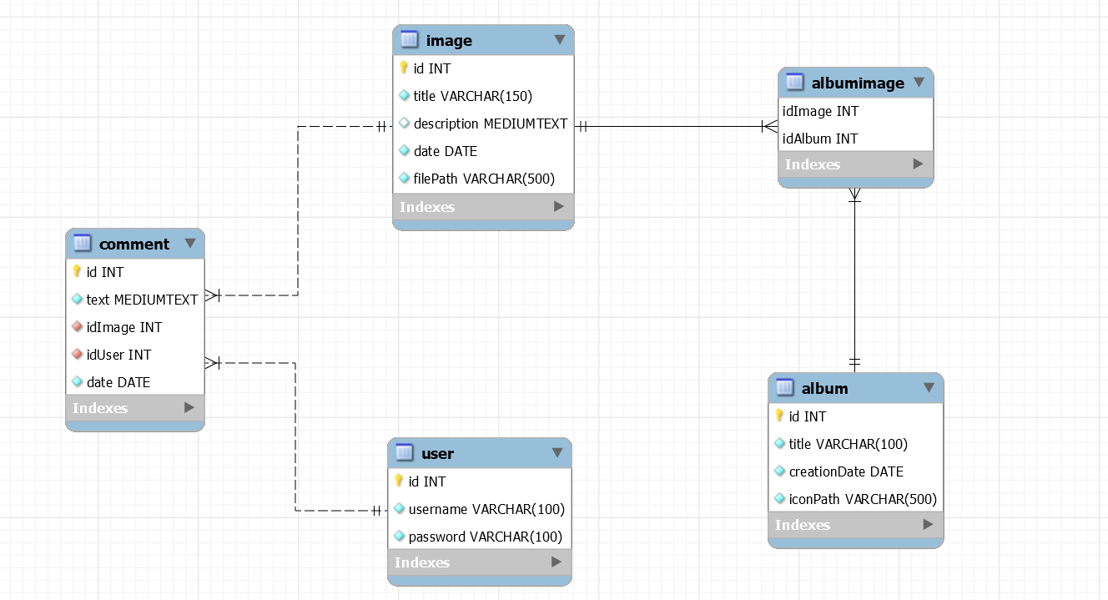
Database design

Slide 2
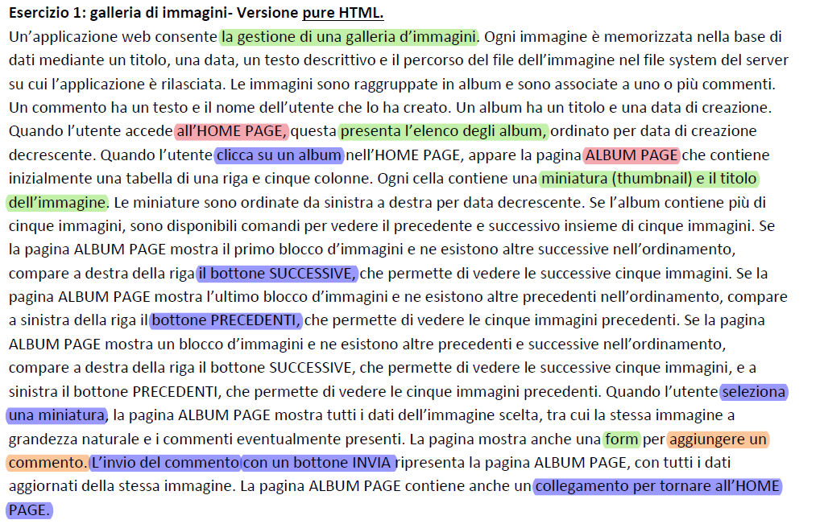
Application requirements analysis
Pages (views), view components, events, actions

Slide 3
APPLICATION DESIGN
username, password
INDEX
Login form [field: username
field: password]
user -> session
Check Login
submit
Continue as Guest
:Button
wrong user + pswd
Create New Account
:Button
submit
submit
Check Guest
ALBUM LIST PAGE
Registration form [field: username
Field: password
field: email]
Open Registration Form
submit
Registration
Wrong parameters/ status ok.

Slide 4
user.id
Next Images
GoToAlbum ListPage
GetImages OfAlbum
Previous Images
ALBUM LIST
Logout
:Button
Ctx.userLogged!=NULL
IMAGE LIST
submit
Logout
:Button
Ctx. userLogged!=NULL
AlbumPage
:Button
Next, previous
Login
:Button
Ctx.userLogged=NULL
submit
submit
Login
:Button
Ctx.userLogged=NULL
submit
:List
[databinding: image]
next
submit
previous
:List
[databinding: album]
select
image.id
:Detail
[databinding: image]
select
album.id
GetImages OfAlbum
:List
[databinding: comment]
Login to Comment
:Button
Ctx.userLogged=NULL
INDEX
GoLogin
Create comment
submit
Text, image.id, user.id
:Form
[text comment]
Ctx.userLogged!=NULL
Logout
submit

Slide 5
Server side: DAO & model objects
Model objects (Beans)
User
Album
Comment
Image
Data Access Objects (Classes)
UserDAO
checkCredentials(username, pwd)
AlbumDAO
findAllAlbums()
findAlbumById(albumId)
findAlbumTitleById(albumId)
ImageDAO
findImagesByAlbum(albumId)
findImageById(imageId)
findDefaultImage(albumId)
CommentDAO
findCommentsOfImage(imageId)
createComment(text, imageId, userId)
findUsernameOfComment(List<Comment>)
RegistrationDAO
createRegistrationOfUser(username,pwd)
controlRegistrationOfUser(userid)

Slide 6
Controllers (servlets)
CheckLogin (Guest)
CheckGuest(Guest)
CreateComment (LoggedUser)
GetImagesOfAlbum (all)
GoLogin(Guest)
GoToAlbumListPage(all)
Logout (LoggedUser)
NextImages (all)
PreviousImages (all)
OpenRegistrationForm (Guest)
Registration (Guest)
Views (Templates) & components
Index (all)
Login (form)
Create New Account (button)
Register (form)
Continue As Guest (button)
AlbumList (all)
Login/Logout(button)
Album (list)
ImageList (all)
Login/Logout(button)
AlbumPage(button)
Image (list)
Previous & next (button)
Image (Details)
Comment (List)
Comment (Form)
Login To comment (button)
Filter
LoggedUser
GuestCheck
NoChacher

Slide 7
Events: access to AlbumList.html
GET/GoToHomePage
GoToHomePage
AlbumDAO
CTX
TemplateEngine
doGet()
findAllAlbums()
albums
ctx.setVariable (“albums", albums)
ctx.setVariable (“userLogged", true/false)
process("albumList.html", ctx, res.getWriter());

Slide 8
Events: click Album
GET /GetImagesOfAlbum?albumId=X
GetImagesOfAlbum
ImageDao
CommentDAO
CTX
TemplateEngine
doGet()
findImagesOfAlbum(X)
images
ImagesToDisplay=
findImagesToDisplay(int previousImages, list<image> images)
chosenImageId = ImagesToDisplay.get(0).getId();
findCommentsOfImage(chosenImageId )
comments
selectedImage = ImagesToDisplay.get(0);
findUsernameOfComments(comments)
Update (comments)
updatePreviousAndNextValue
(0 , 0, numberOfBlocks)
albumTitle=
getAlbumTitleFromId(X)
ctx.setVariable(ImagesToDisplay, X, chosenImageId, selectedImage, comments, nextImages, previousImages, albumTitle);
process("imageList.html", ctx, res.getWriter());

Slide 9
Events: selection of Thumbnail image
GET /GetImagesOfAlbum?albumId= X &imageId= Y&nextImages=H&previousImages=K
GetImagesOfAlbum
CommentDAO
ImageDAO
CTX
TemplateEngine
doGet()
findCommentsOfImage(Y)
updatePreviousAndNextValue
(H , K, numberOfBlocks)
albumTitle=getAlbumTitleFromId(X)
comments
findImageById(Y)
selectedImage
ctx.setVariable(X, Y, selectedImage, comments, nextImages, previousImages, albumTitle);
process("imageList.html" ctx, res.getWriter());

Slide 10
Events: click next button
POST/NextImages
AlbumId → alId
nextImages → urlNextImages
previousImages → urlPreviousImages
NextImages
GetImagesOfAlbum
doPost()
La servlet aggiorna i valori di next e previous:
urlNextImages = next -1 ;
urlPreviousImages = previous + 1;
Redirect /GetImagesOfAlbum?albumId=alId &nextImages= urlNextImages &previousImages=urlPreviousImages

Slide 11

Events: click previous button
POST/PreviousImages
AlbumId → alId
nextImages → urlNextImages
previousImages → urlPreviousImages
PreviousImages
GetImagesOfAlbum
doPost()
La servlet aggiorna i valori di next e previous:
urlNextImages = next + 1 ;
urlPreviousImages = previous -1;
Redirect /GetImagesOfAlbum?albumId=alId &nextImages= urlNextImages &previousImages=urlPreviousImages

Slide 12
Events: creation of message
CreateComment
Session
CommentDAO
GetImagesOfAlbum
doPost()
getAttribute("user");
POST /CreateMessage
Comment → comment
ImageId → imgId
AlbumId → alId
nextImages → urlNextImages
previousImages → urlPreviousImages
user
CreateMessage(comment , imgId, user.getId())
Redirect /GetImagesOfAlbum?albumId=" + alId + "&imageId=" + imgId +
"&nextImages=" + urlNextImages + "&previousImages=" + urlPreviousImages

Slide 13
Events: Open Registration form
GET /OpenRegistrationForm
OpenRegistrationForm
CTX
TemplateEngine
doGet()
ctx.setVariable("RegistrationForm", true);
process("index.html", ctx, res.getWriter());

Slide 14
Events: Check Login
doPost /CheckLogin
CheckLogin
UserDAO
Index.html
Session
GoToHomePage
doPost()
checkCredentials(usrn, pwd)
POST:
Username -> usrn
Password -> pwd
From: index.html
User
[User == null]
Redirect “Index.html”
[User != null ] setAttribute ("user", User)
[User != null]
Redirect /GoToHomePage

Slide 15
Events: Check Guest
GET /CheckGuest
CheckGuest
GoToHomePage
doGet()
Redirect /GoToHomePage

Slide 16
Events: Logout
GET /Logout
Logout
Session
Index.html
doGet()
[session != null ] invalidate()
Redirect “Index.html”

Slide 17
Events: Registration Submit
Registration
RegistrationDAO
CTX
TemplateEngine
doPost()
controlRegistrationOfUser(usrn)
POST /Registration
Cond: TRUE || FALSE
IF [Cond && pwd.equals(pwdRepeated)]
createRegistrationOfUser(usrn, pwd)
ctx.setVariable("checkUsername", false)
POST:
Username -> usrn
Password -> pwd
Password repeated-> pwdRepeated
From: /OpenRegistrationForm
process("index.html", ctx, response.getWriter());
[ELSE]
ctx.setVariable("RegistrationForm", true);
[!password.equals(pwdRepeated)]
ctx.setVariable("WrongPasswords", true);
[!registrationDAO.controlRegistrationOfUser(usrn)]
ctx.setVariable("checkUsername", true);
process("index.html", ctx, response.getWriter());

